Slide 1

Car Insurance Customer Prediction
Eunbin Yoo
Data Science Project
Customer Analysis Using PCA and K-means Clustering Algorithm

Slide 2
Problem Statement
An insurance company seeks to expand its offerings by introducing vehicle insurance to its existing health insurance customers. To achieve this, we aim to build a predictive model to determine whether policyholders from the past year will be interested in purchasing vehicle insurance.
Project Task:
By analyzing a dataset that includes demographics (gender, age, region code type), vehicle details (vehicle age, damage history), and policy specifics (premium amount, sourcing channel), we aim to develop a model that accurately forecasts which customers are likely to purchase vehicle insurance.

Slide 3
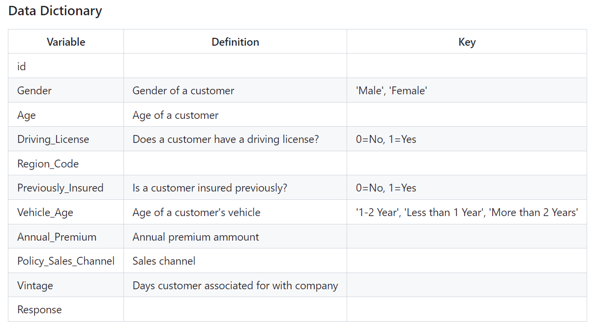
Dataset Used
Data Dictionary
The dataset used in this project is “Health Insurance Cross Sell dataset” uploaded on Kaggle under a public domain.
This dataset involves information about demographics, vehicles and insurance policy. Each row represents a health insurance customer.

Slide 4
Approach
The project involves these steps:
Data Pre-processing: Data cleaning, handling missing values, feature scaling, and encoding categorical variables
Exploratory Data Analysis (EDA): Descriptive analysis and visualizations
Feature Engineering: Creation, transformation and selection of features
Model Building: Regression algorithms for binary classification model, such as logistic linear regression and random forests classifier
Model Evaluation: Area Under The Curve (AUC) Score
1
2
3
4
5

Slide 5
Key Findings 1
The cross-sell analysis provided valuable insights into the dynamics of customer behavior and preferences.
1
The findings highlight notable demographic trends, such as the higher interest among male
customers compared to females and the age distribution of interested customers, particularly the
significant proportion within the 40-49 age group. Understanding these demographic nuances is
essential for refining marketing strategies and optimizing outreach efforts.
2
2. The observed negative correlation between age and policy sales channel preference offers
valuable guidance for optimizing sales channel allocation and customer outreach strategies. By aligning outreach channels with customer preferences, insurers can enhance engagement and conversion rates.

Slide 6
Key Findings 2
The cross-sell analysis provided valuable insights into the dynamics of customer behavior and preferences.
3
3. The utilization of a Light Gradient Boosting Model has significantly enhanced our predictive
accuracy, with an impressive AUC score of 86%, indicating its robust performance in identifying potential customers interested in vehicle insurance.
4. The analysis underscores the significance of annual premium as the most influential
determinant in predicting customer interest in additional insurance products. This insight suggests the importance of tailored pricing strategies and personalized offerings to effectively target and engage potential customers.
4

Slide 7
Visualizations
Data visualizations using matplotlib and seaborn

Slide 8
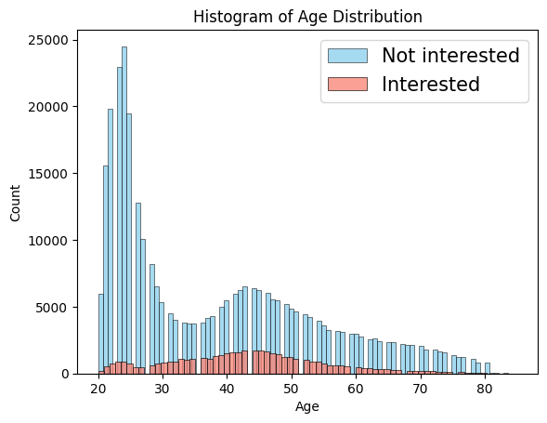
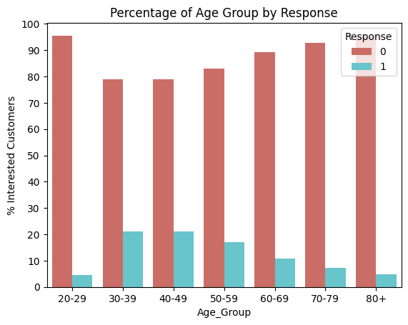
Age Distribution of Customers
The bar chart shows that 40-49 is the age group with the largest proportion of interested customers (20.1%). The proportion of the customers interested in vehicle insurance is smaller in older age groups.

Slide 9
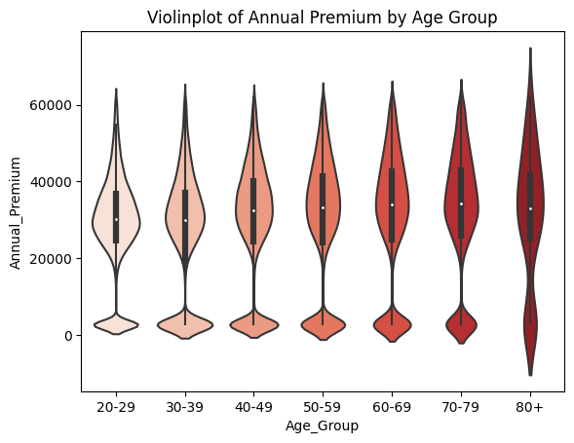
Age Vs. Annual Premium Relationship
The violin plot shows that older customers pay higher annual premium than younger customers on average.

Slide 10
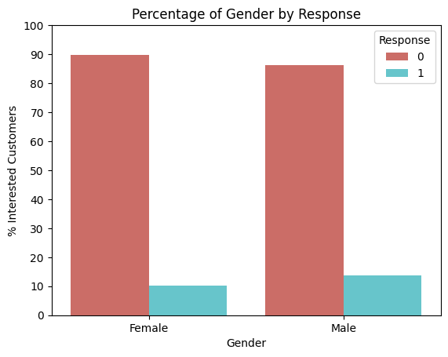
Gender Distribution
About 3% more male customers are interested in vehicle insurance than female customers.

Slide 11
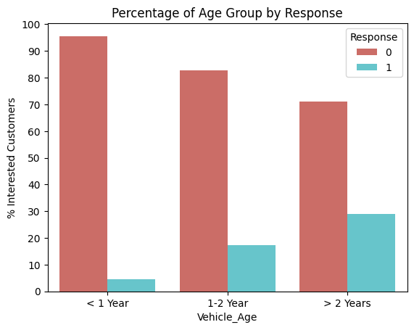
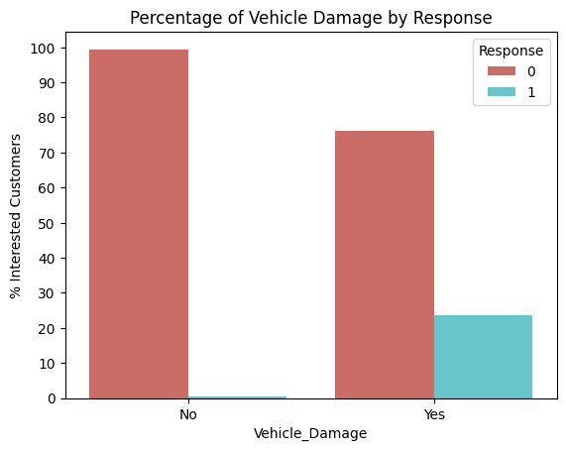
Vehicle Damage and Age
Customers whose vehicles are older or have damage are more interested in vehicle insurance. Only few customers who does not have damage on their vehicles are interested.

Slide 12
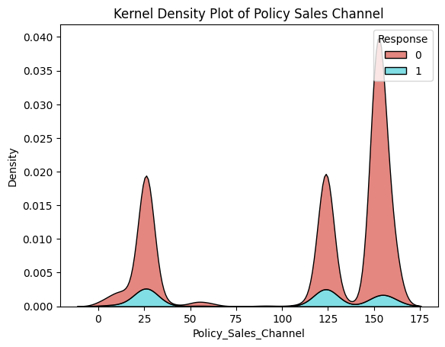
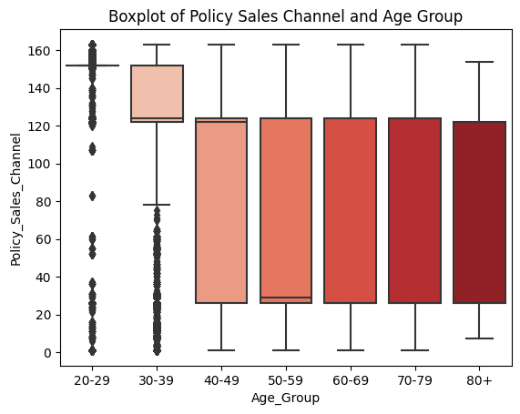
Policy Sales Channel Distribution
The plots suggest that there is a difference in preference for Policy Sales Channel between different age groups. Younger age groups tend to prefer higher Policy Sales Channel code, while older age groups tend to prefer Lower Policy Channel code.

Slide 13
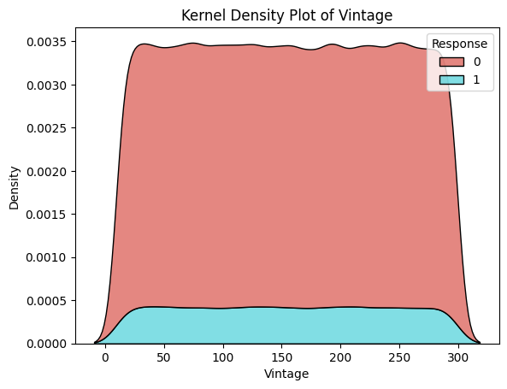
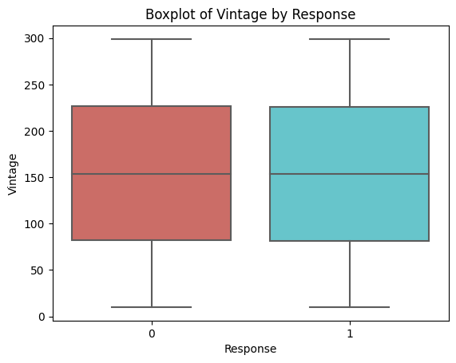
Vintage Distribution
The density plot shows that there is almost no difference in the average number of days customers have been associated with the company between those who are interested in Vehicle insurance and those who are not.

Slide 14
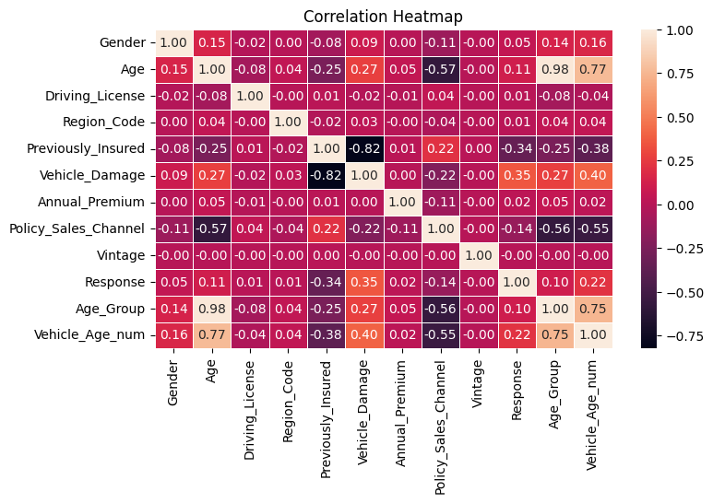
Correlation Analysis
The heat map shows a moderate negative
correlation (-0.57) between Age and Policy
Sales Channel, suggesting that older age
group prefers to be outreached by lower
Policy Sales Channel code.
There is a fair positive correlation (0.75)
between Vehicle Age and Age. Older age
group has older vehicles.

Slide 15
Model Building and Evaluation
Binary classification model using various machine learning algorithms

Slide 16
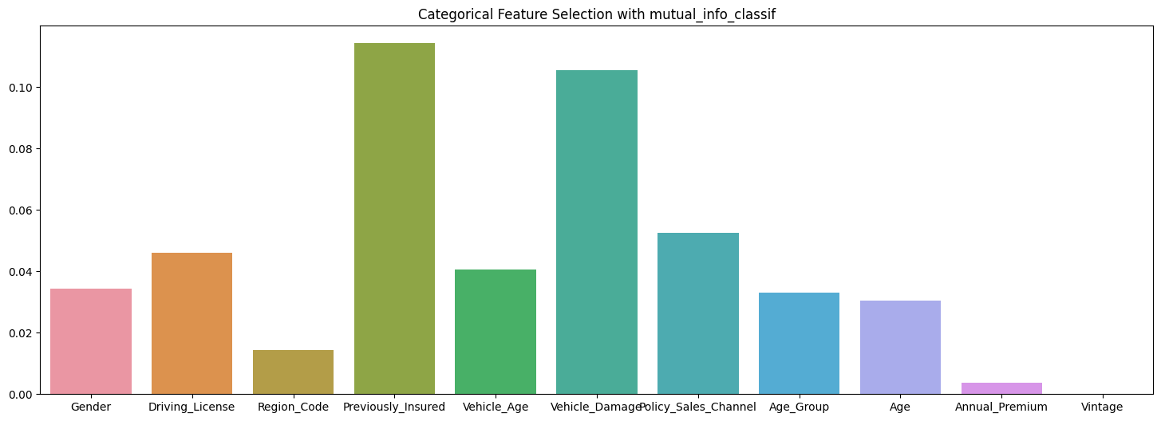
Feature Selection
According to K-scores, ‘Age’ and ‘Vintage’ are dropped from the final dataset.
The chart shows that adding age groups as a new feature brings small improvement.
Vintage has the lowest k-score.

Slide 17
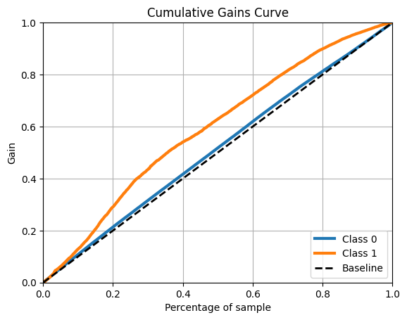
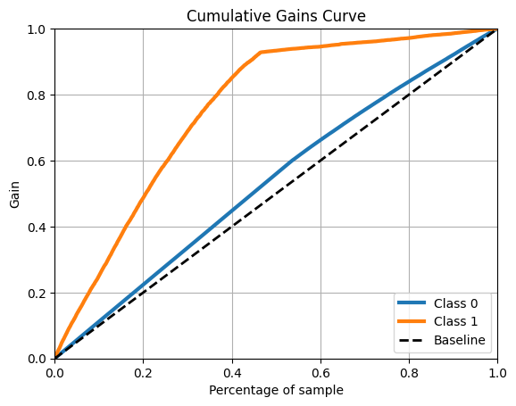
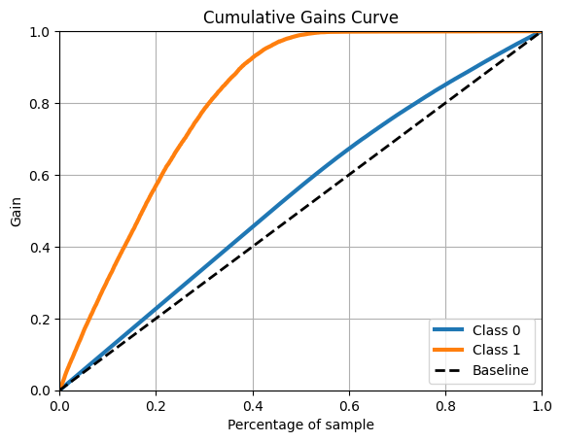
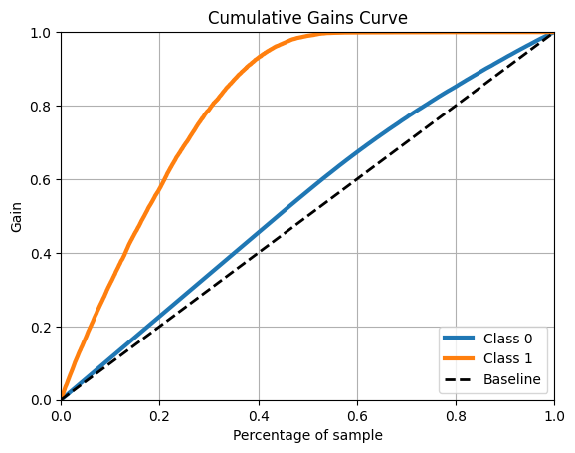
Cumulative Gains Curve
Logistic Regression, Random Forest Classifier, XGBoost Classifier and LGBM Model are built.
Model 1:
Logistic Regression
Model 2:
Random Forest Classifier
Model 3:
XGBoost Classifier
Model 4:
LGBM

Slide 18
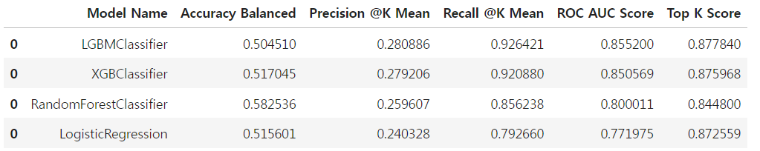
Model Performance
I chose the model with the best cost-benefit ratio (higher score, lower size, higher speed).
Final Model
The utilization of a Light Gradient Boosting Model has significantly enhanced our predictive accuracy, with an impressive
AUC score of 86%, indicating its robust performance in identifying potential customers interested in vehicle insurance.
Final model is a Light Gradient Boosting Model with the highest AUC score of 0.86.

Slide 19
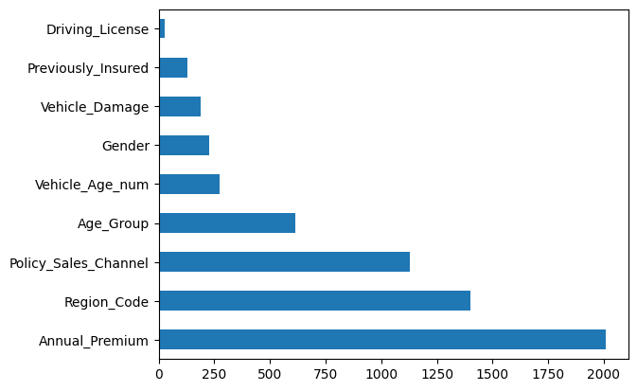
Feature Importance
The model suggests that
Annual Premium is the
most important feature in
predicting whether a
customer is interested in
Vehicle insurance.
Driving License is the least
important feature.

Slide 20
Conclusion
Limitations:
The analysis reveals a weakness in the form of data imbalance, where only 12% of customers are interested in vehicle insurance. Addressing this imbalance through oversampling techniques may resolve this issue and potentially improve the overall model performance by providing more balanced representation of both interested and non-interested customers.
Conclusions:
In conclusion, the analysis not only provides actionable insights for optimizing cross-selling strategies but also demonstrates the efficacy of advanced modeling techniques in extracting meaningful patterns from complex datasets. These insights can empower insurers to tailor their marketing approaches, deepen customer relationships, and drive business growth in an increasingly competitive marketplace.

Slide 21
Thank you
Link to Original Dataset: https://www.kaggle.com/datasets/anmolkumar/health-insurance-cross-sell-prediction/data?select=train.csv
Github Link for code, resources and more information: https://github.com/bebe5004/Eunbin-Yoo-s-Portfolio/tree/main/Car%20Insurance%20Sales%20Prediction
Github page for more projects: https://github.com/bebe5004/Eunbin-Yoo-s-Portfolio/tree/main?tab=readme-ov-file#readme

